Slide 1
Reducing “Unknown” Misoperation Causes
Bill Middaugh, Tri-State G & T

Slide 2
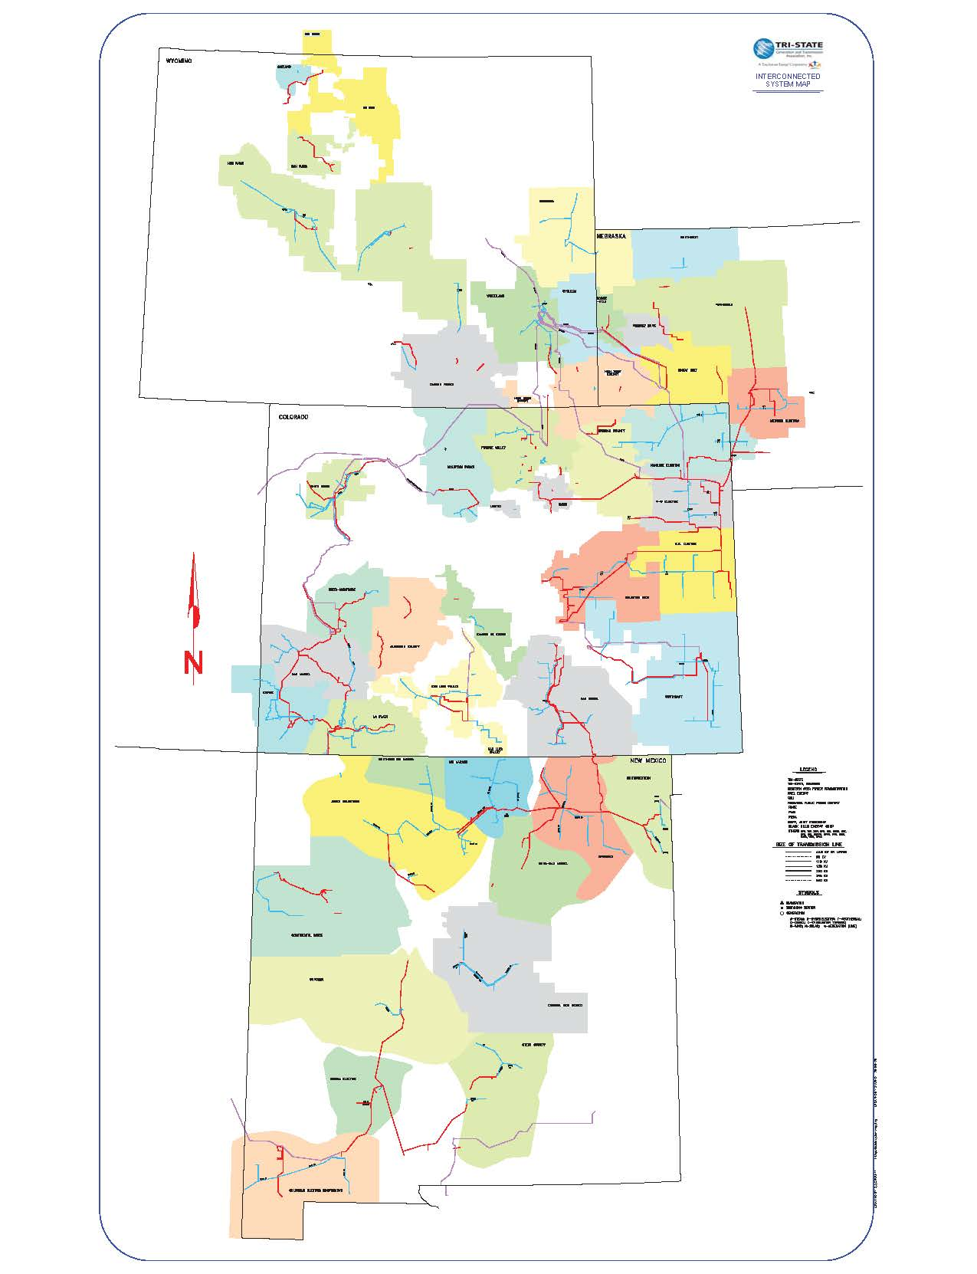
Tri-State G & T Ass’n.
5485 Miles of Transmission Lines at 115 kV or higher
About 140 Substations with Relays Protecting BES Elements
Most in WECC but some in the MRO

Slide 3
Tri-State Organization
43 customers
Each customer (TSGT Member) has a representative on the Tri-State Board of Directors
Each Member’s operations manager receives copies of interruption reports and is comfortable with contacting our executive management

Slide 4
What’s Working at Tri-State
Each customer gets copies of our operation reports so they can tell if an outage they had was associated with a correct operation.
They are comfortable with contacting our executive management directly.
Identifying and mitigating misoperation causes has been a high priority for a long time.
PRC-004 NERC expectations.
Use of tools such as DFRs and mproc relays leads to successes in identifying causes.
Management support.
Culture of expected identification of causes.

Slide 5
Tenet #1
EVERY MISOPERATION HAS A CAUSE

Slide 6
Tenet #2
THE CAUSE OF EVERY MISOPERATION CAN BE IDENTIFIED

Slide 7
NERC Expectations
PRC-004-5(i) – Application Guidelines: Requirement R4 is intended to provide a mechanism to continue a diligent review of Misoperations to determine causes after the time periods defined in Requirements R1 and R3 and not to provide an immediate opportunity to classify the cause as “Unknown.”
Disclaimer – I am not an auditor, but I believe that the language in R4 requires entities not to declare a Misoperation as “Unknown” until at least two full calendar quarters after the Misoperation identification.

Slide 8
Tools
40 Substations with digital fault recorders
Over 260 Substations with microprocessor relays
Almost 120 substations have microprocessor relays protecting BES elements

Slide 9
Intangibles
Management Support
Installation of DFRs and relays with event capability
Allow engineers and technicians the time to research
Culture of expected identification

Slide 10
Summary
We believe that the cause of every misoperation can be identified.

Slide 11
To Reduce “Unknown” Misoperation Causes…
If you are finding that insufficient data is available to identify causes, stress the importance of recording tools.
The Benefit?
Customer satisfaction and perhaps less RE and ERO scrutiny.
Consistent, early, thorough evaluation of operations and Misoperations can lead to faster and more accurate classification, allowing more time to spend with the ones you love!
Every Misoperation has a cause,
and it can be identified.

